Slide 1
Machine Learning

Slide 2
Data from business is mined to generate intelligence.
This makes business better, in an unending cycle.

Slide 3
What is Predictive Analytics?
Where is Predictive Analytics used?
How does Predictive Analytics work?

Slide 4
Predictive Analytics helps connect data to effective action by drawing reliable conclusions about current conditions and future events.
Predictive analytics is the practice of extracting information from existing data sets in order to determine patterns and predict future outcomes and trends. Predictive analytics does not tell you what will happen in the future.

Slide 5
Predictive analytics encompasses a variety of statistical techniques from data mining, predictive modelling, and machine learning, that analyze current and historical facts to make predictions about future or otherwise unknown events.
Predictive analytics involves extracting data from existing data sets with the goal of identifying trends and patterns. These trends and patterns are then used to predict future outcomes and trends

Slide 6
Applications of Machine Learning
Facebook Facial Recognition-automaticallly tags
Voice recognition
Facebook ads

Slide 7
Since the dawn of time
Up until 2005
Humans had created
130 exabytes of data
2010- 1200 exabytes
2015- 7900 exabytes
2020- 40,900 exabytes estimated

Slide 8
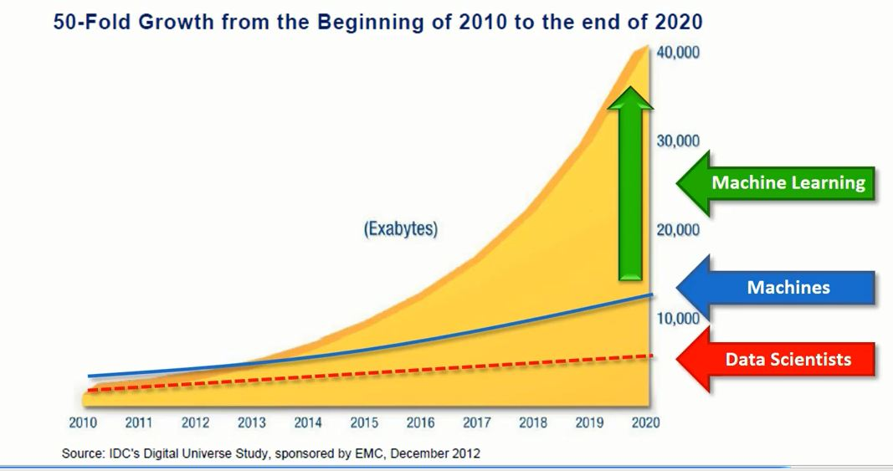

Slide 9
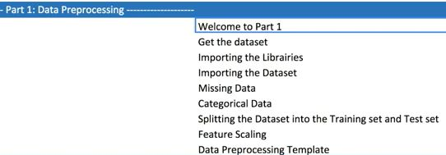

Slide 10
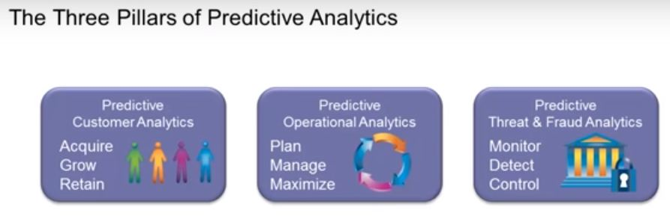

Slide 11
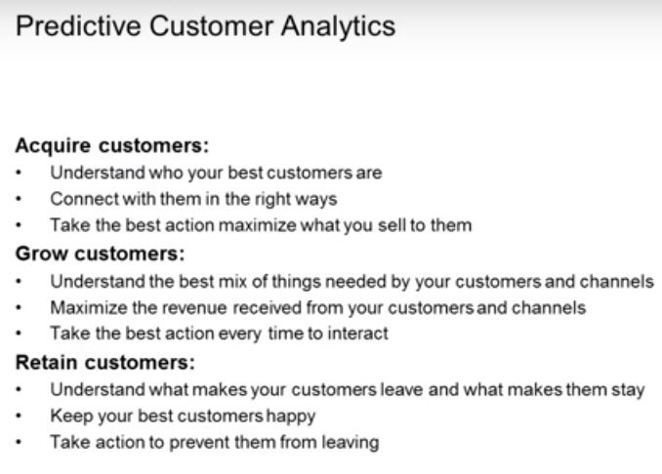

Slide 12
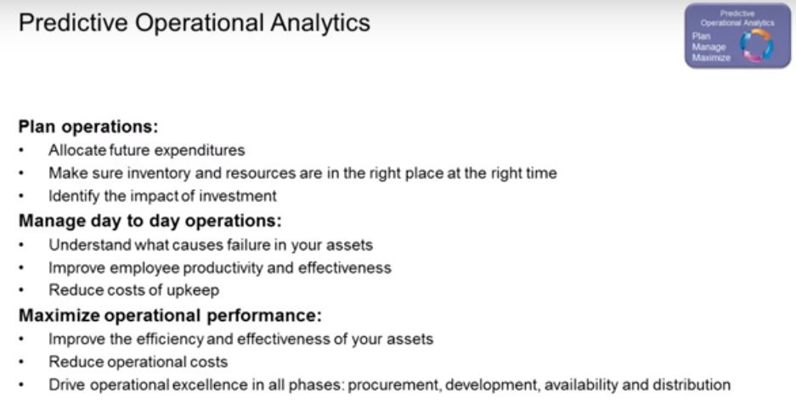

Slide 13
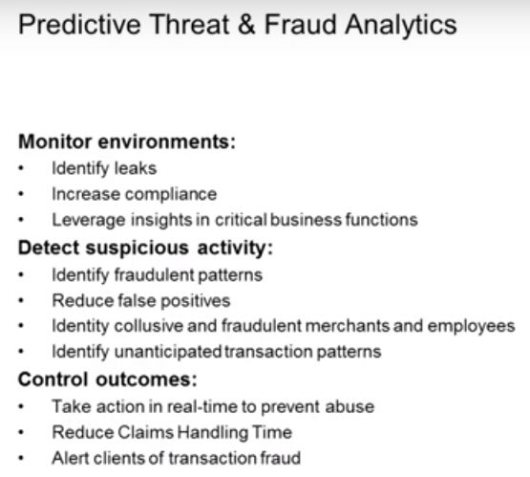

Slide 14
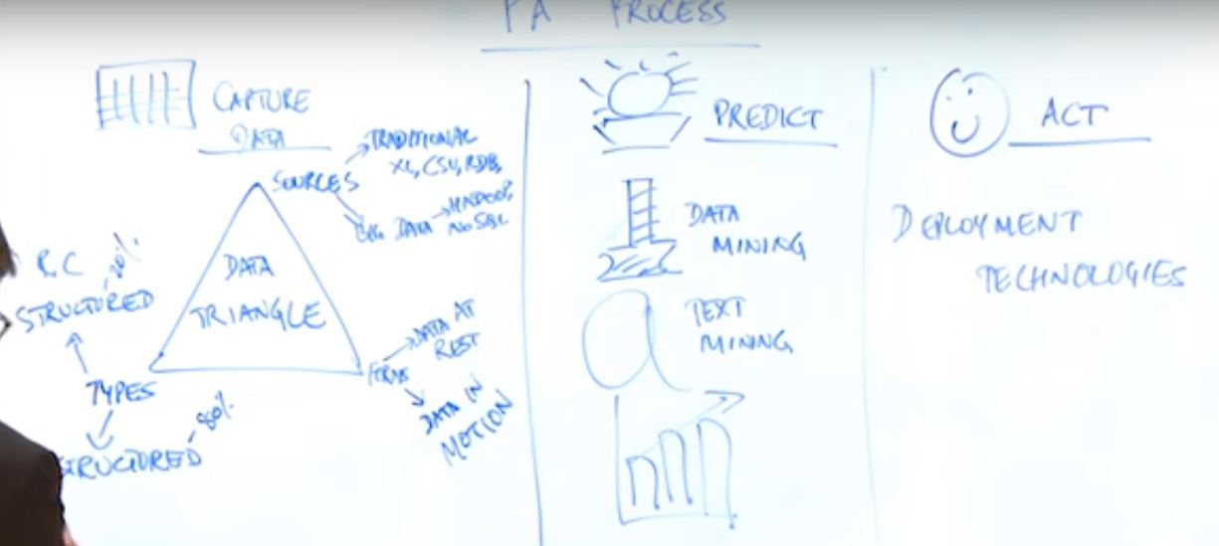

Slide 15
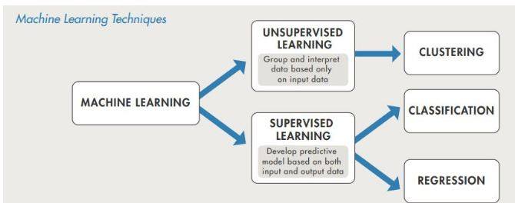

Slide 16
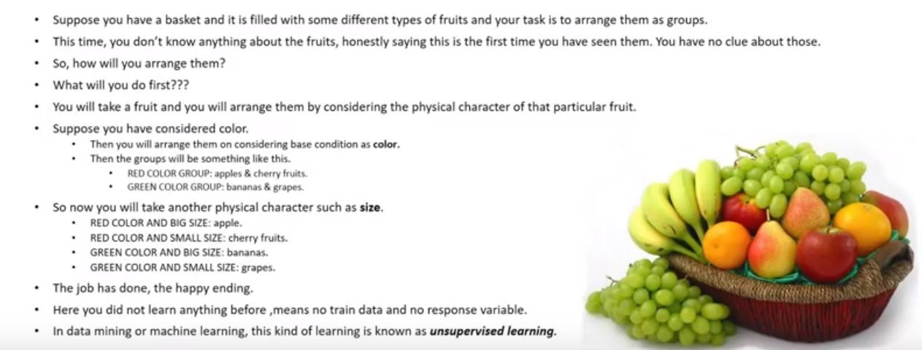
Unsupervised Learning

Slide 17
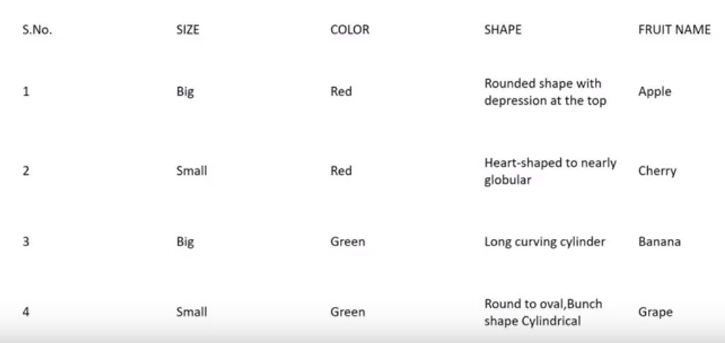
Supervised Learning

Slide 18
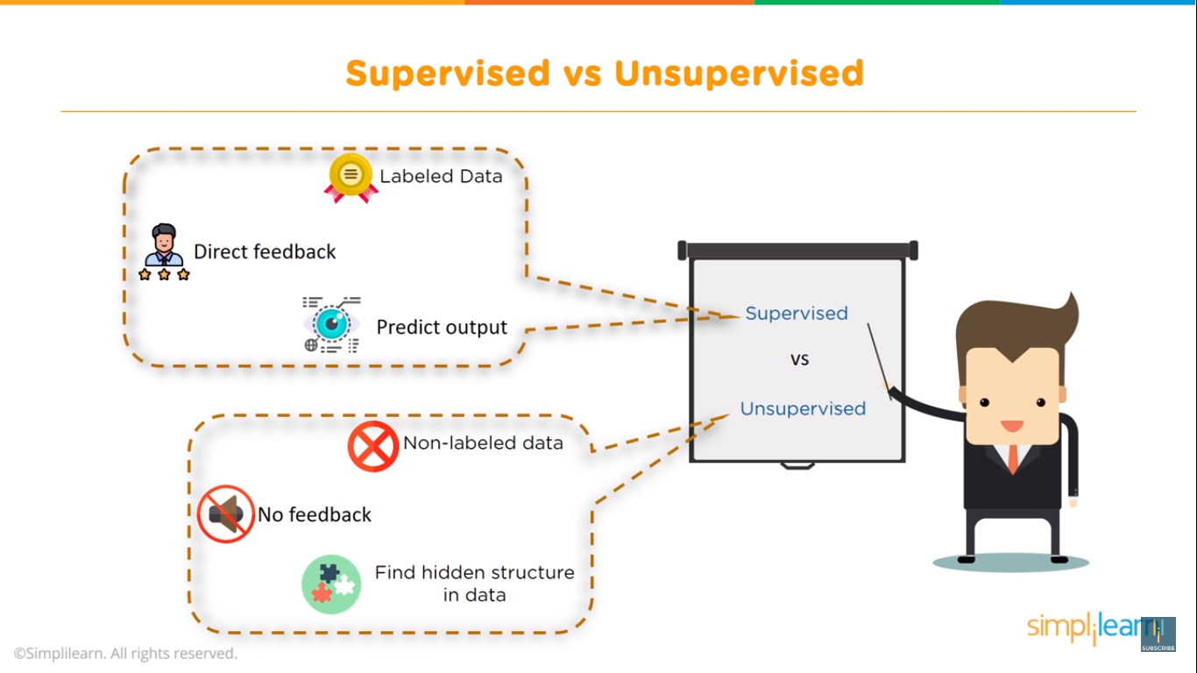

Slide 19
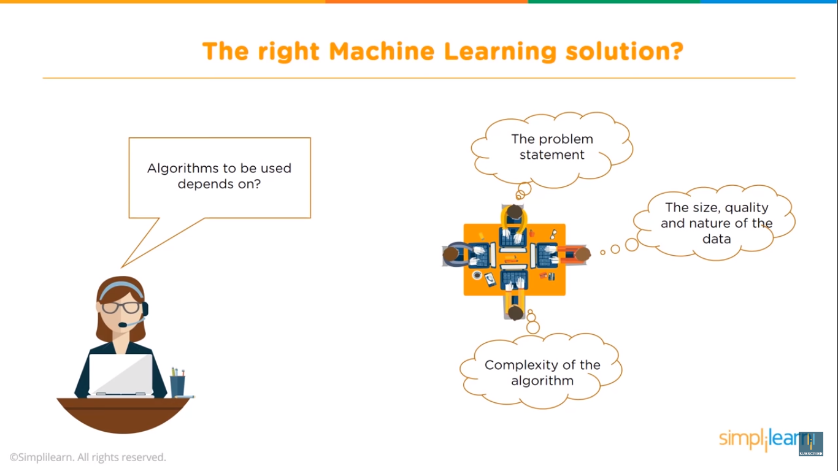

Slide 20
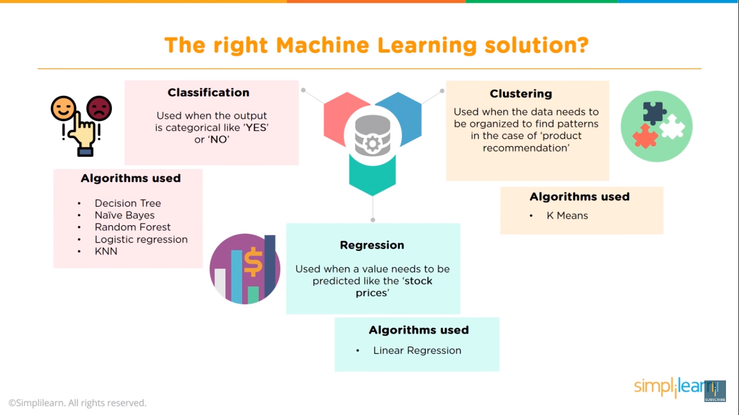

Slide 21
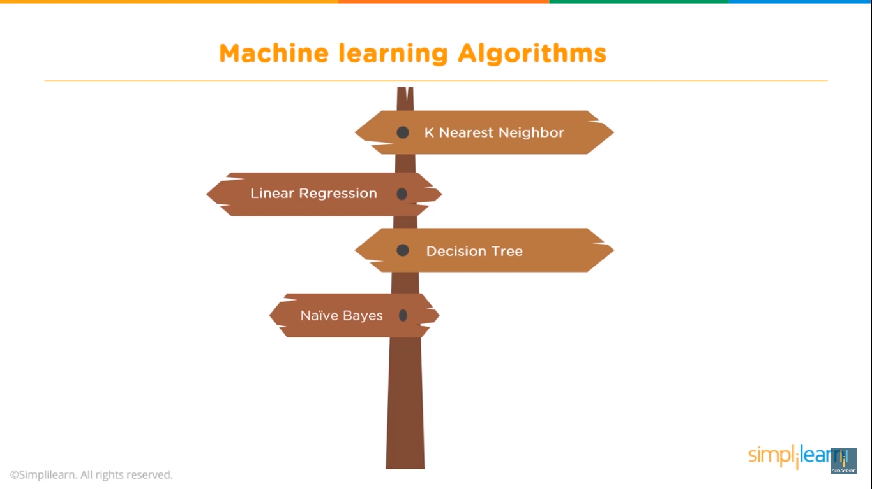

Slide 22
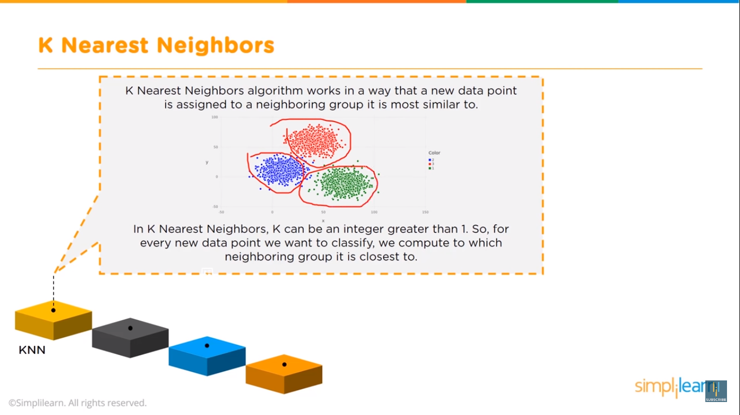

Slide 23
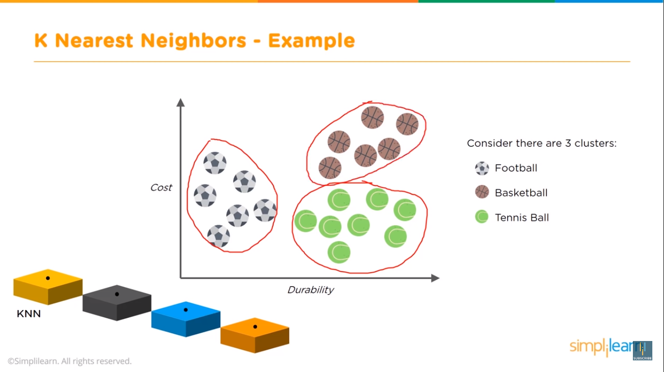

Slide 24
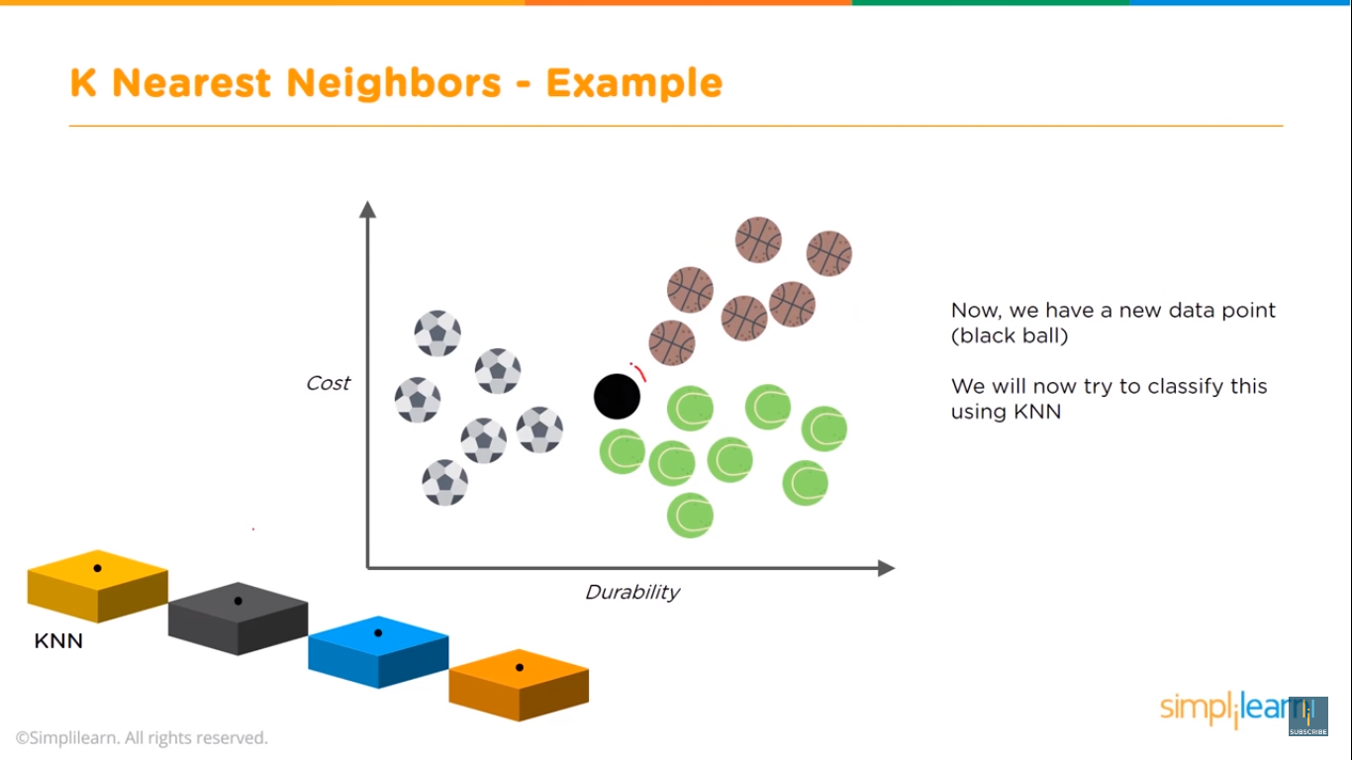

Slide 25
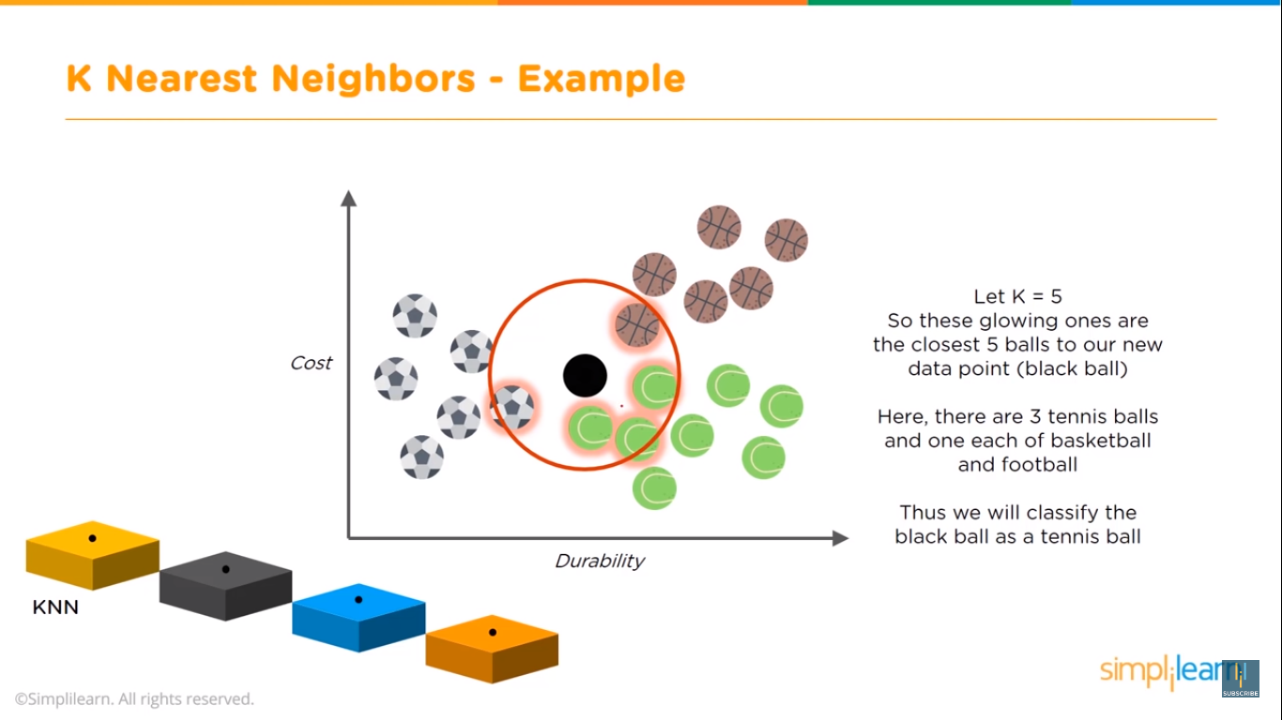

Slide 26
KNN
In a single sentence, nearest neighbor classifiers are defined by their characteristic of classifying unlabeled examples by assigning them the class of similar labeled examples. Despite the simplicity of this idea, nearest neighbor methods are extremely powerful. They have been used successfully for:
• Computer vision applications, including optical character recognition and facial recognition in both still images and video
• Predicting whether a person will enjoy a movie or music recommendation
• Identifying patterns in genetic data, perhaps to use them in detecting specific proteins or diseases

Slide 27
The k-NN algorithm gets its name from the fact that it uses information about an example's k-nearest neighbors to classify unlabeled examples.
The letter k is a variable term implying that any number of nearest neighbors could be used. After choosing k, the algorithm requires a training dataset made up of examples that have been classified into several categories, as labeled by a nominal variable.
Then, for each unlabeled record in the test dataset, k-NN identifies k records in the training data that are the "nearest" in similarity. The unlabeled test instance is assigned the class of the majority of the k nearest neighbors.

Slide 28
The first is a measure from 1 to 10 of how crunchy the ingredient is and the second is a 1 to 10 score of how sweet the ingredient tastes.
We then labeled each ingredient as one of the three types of food: fruits, vegetables, or proteins. The first few rows of such a dataset might be structured as follows:

Slide 29
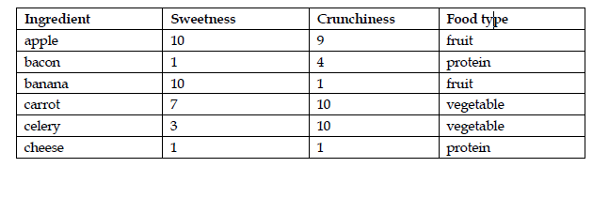

Slide 30
The k-NN algorithm treats the features as coordinates in a multidimensional feature space. As our dataset includes only two features, the feature space is two-dimensional.
We can plot two-dimensional data on a scatter plot, with the x dimension indicating the ingredient's sweetness and the y dimension, the crunchiness. After adding a few more ingredients to the taste dataset, the scatter plot might look similar to this:

Slide 31
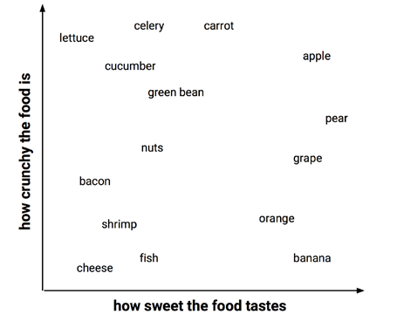

Slide 32
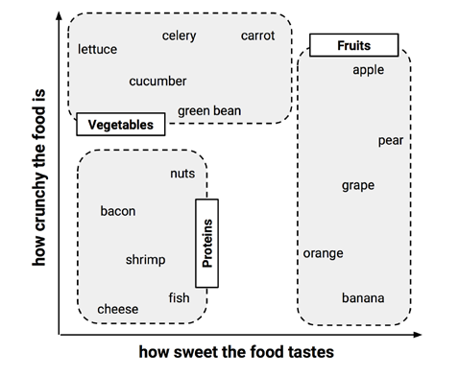

Slide 33
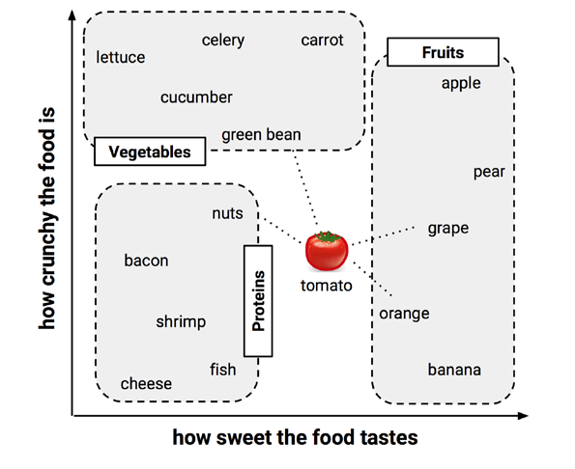

Slide 35
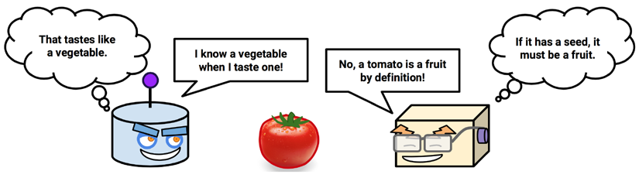
K-NN is lazy! Why?????

Slide 36
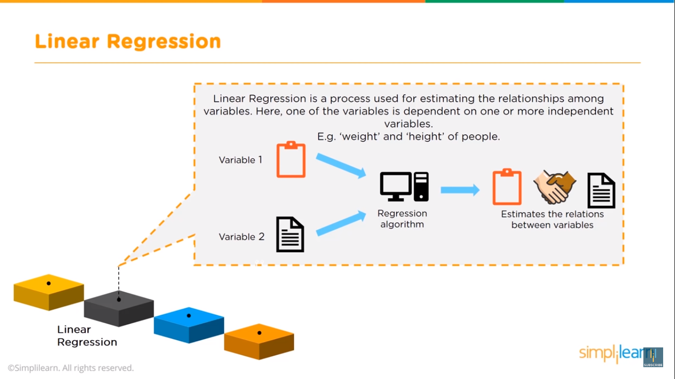

Slide 37
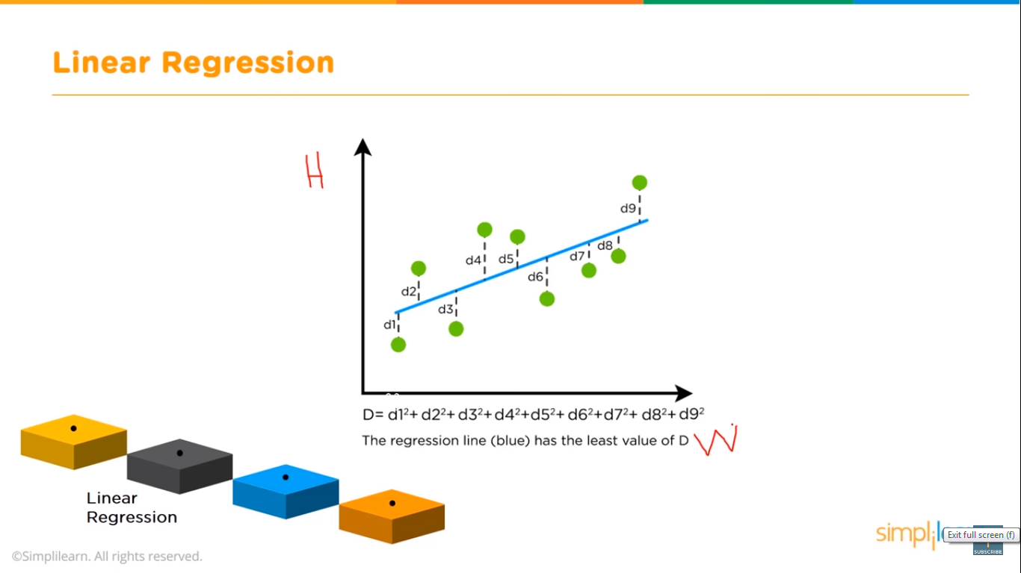

Slide 38
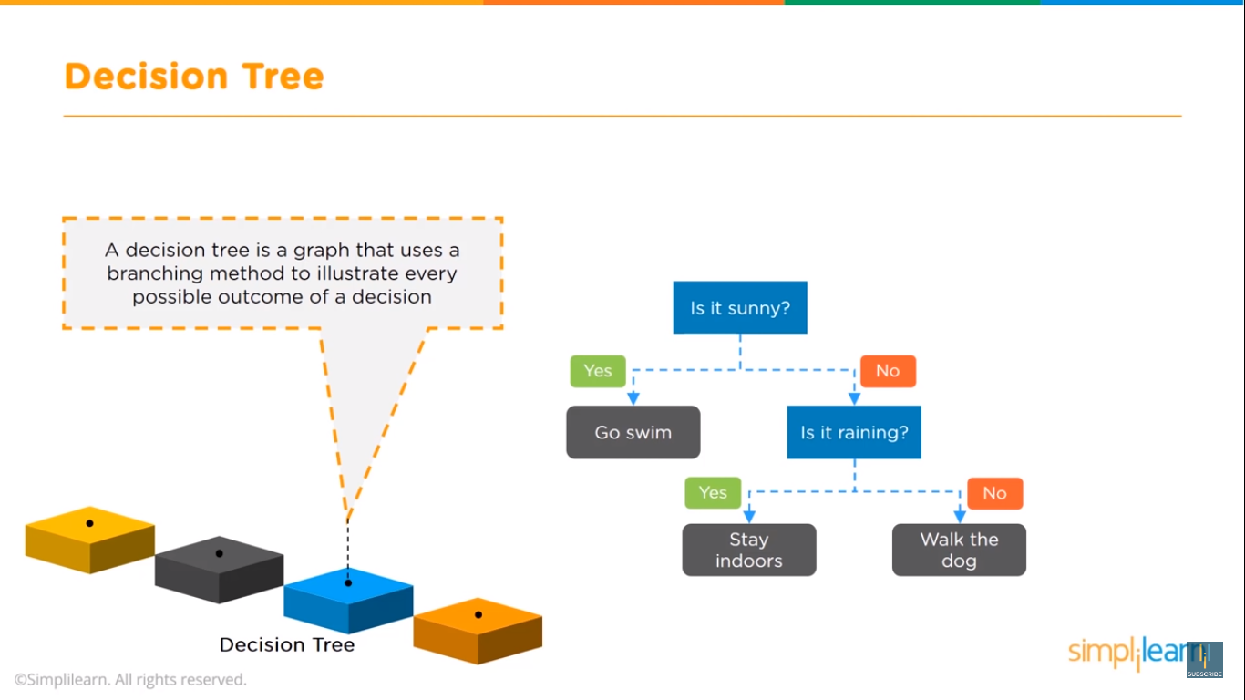

Slide 39
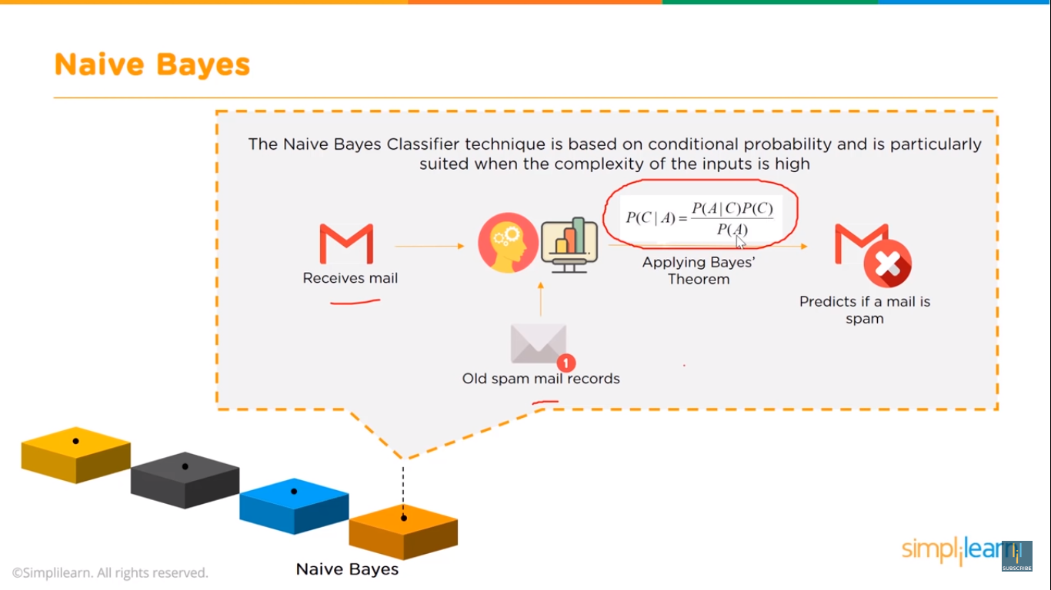

Slide 40
